Slide 1
Transforming Health Care Delivery in Oregon through Technology and Robust Health Information Exchange Susan Otter Director of Health Information Technology July 2017

Slide 2
Behavioral Health Agency HIT Survey: Methods Used for Information Exchange
More Robust
Preliminary OHA survey results, June 2017.
95 out of 285 BH agencies (33%), represents 389 programs out of 883 total (44%)

Slide 3
Behavioral Health Agency HIT Survey: Top Barriers for Electronic Sharing
 | Top Barriers to Electronic Sharing | Count | Response Rate
1 | Financial Cost | 73 | 77%
2 | Concerns about privacy and security | 61 | 64%
3 | Technical resources are limited | 58 | 61%
4 | Concerns over liability of re-disclosure of information | 47 | 49%
Preliminary OHA survey results, June 2017.
95 out of 285 BH agencies (33%), represents 389 programs out of 883 total (44%)

Slide 4
ONC Advancing Interoperable HIT Services to Support HIE Cooperative Agreement
Oregon’s award: $2.2m, July 2015-July 2017
12 total states awarded, 4 states received supplemental grant funds in 2016
OHA solicted letters of interest from potential sub-recipients, selected Jefferson HIE/Reliance
Funding Purpose:
Increase adoption of HIE
Increase interoperable exchange and use, and
Increase the integration of data by care providers
Target populations:
Connecting physical health providers and/or Critical Access Hospitals to behavioral health and other non-physical health providers.

Slide 5
ONC Advancing Interoperable HIT Services to Support HIE Cooperative Agreement
Oregon’s project:
Address barriers to HIE and care coordination
Integrate behavioral and physical health data
Specifically:
Common consent model to support appropriate sharing of specially protected health information (e.g., 42 CFR Part 2)
Connect with the Veterans Administration (VA) and Social Security Administration (SSA)
Connect with the Prescription Drug Monitoring Program
Provide real-time clinical notifications including hospital event (EDIE) data
Provide technical assistance for workflow redesign to maximize HIE/HIT investments

Slide 6
Spreading Grant-Funded Work in Oregon
OHA Behavioral Health Information Sharing Workgroup
Developing a strategy to support integrated care and services by enabling the electronic sharing of behavioral health information between providers
Resources:
Developed webinars, FAQs and other resources to work to clarify misconceptions and confusion about applicable state and federal privacy laws that may currently limit information sharing.
Provider Toolkit:
Common consent model to support appropriate sharing of specially protected health information (e.g., 42 CFR Part 2)
Sample Qualified Service Organization Agreement (QSOA)
Case studies, FAQs, state/federal laws comparispn
www.oregon.gov/oha/HPA/CSI-BHP/Pages/Behavioral-Health-Info.aspx

Slide 7
Changing Behavioral Health Landscape
Behavioral Health Collaborative – transforming the BH system: 4 recommendations
Certified Community Behavioral Health Clinics (CCBHCs): care integration and value-based payment
Other data and metrics:
2018 CCO Incentive Metric:
Emergency department (ED) utilization for individuals experiencing severe and persistent mental illness (SPMI).
Measures and Outcomes Tracking System (MOTS)
U.S. Dept. of Justice agreement

Slide 8
Behavioral Health Collaborative Recommendations Overview
Governance and finance: Regional governance model for behavioral health
Standards of care and competencies
Workforce
Information exchange and coordination of care
Adoption of electronic health records (EHRs)
Health Information Exchange for care coordination
Data for treatment and quality improvement
Support for performance-based measures and payment models
Patient access
http://www.oregon.gov/oha/HPA/CSI-BHP/Pages/Behavioral-Health-Collaborative.aspx

Slide 9
Oregon Standards for Certified Community BH Clinics (CCBHCs) with technology implications
Performance tracking, population management, and clinical quality measuring
Coordination and integration with primary care
Comprehensive and up-to-date patient records
Specialized care setting transitions (hospital transitions)
Care coordination
End-of-life planning
http://www.oregon.gov/oha/HPA/CSI-BHP/CCBHC%20Documents/Oregon-Standards-for-CCBHCs.pdf

Slide 10
Opportunities for Behavioral Health
Care coordination
Performance metrics show value
Shared governance and Supports
New payment models support transformation
Health information technology
Notes:
High-level take away of future. Growing, changing and emerging opportunities.

Slide 11
HIT Components for CCO Consideration
Foundational Components:
Adoption of Certified EHRs
Facilitation of Health Information Exchange
Complex care coordination; Referrals; Event notifications
Data to support value based payment models
Clinical quality metrics reporting and CCO Quality Incentives
Value-based payment and population management:
Tools to support analytics, improve quality, manage risk
Risk stratification, identification of care gaps
Tying clinical outcomes to payment
New sources of data to have “line of sight” to innovate and adjust

Slide 12
Oregon HIT highlights in 2016-2017
High adoption of electronic health records
Health information exchange spreading:
Widespread use of EDIE/PreManage
New Oregon footprint for national HIE efforts
Spread and investment in regional HIEs
New “drivers” - value-based payment
Medicare Meaningful Use transitioning to MACRA MIPS
Oregon alignments across payers and metrics planned
Focus on population management, behavioral health and social determinants

Slide 13
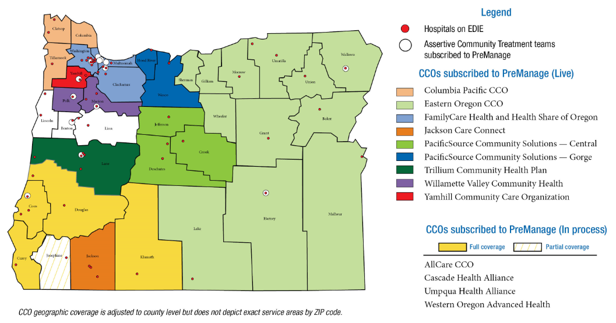
Adoption of Hospital Notifications by CCOs, Hospitals, and ACT Teams
Notes:
-A statewide EDIE and PreManage online Learning Community kicked off in December 2016 and has more than 250 participants.
- OHA launched a CCO Medicaid subscription in 2016 and adoption continues to increase.
CCOs: 10 live, 2 onboarding.
Dental care organizations: 3 live, 2 onboarding
Assertive Community Treatment Teams: 14 live, 2 onboarding, 7 to be engaged in 2017
Fee-for-service: KEPRO, OHA’s statewide care coordination contractor for Medicaid’s fee-for-service population is live
-Oregon’s Department of Human Services, Aging and People with Disabilities (APD) program is conducting a PreManage pilot with four APD districts and two Area Agencies on Aging sites; staff have been trained and are live on PreManage.
-An EDIE and PreManage Behavioral Health User Community started meeting quarterly to develop use cases, share best practices and network.
-It is expected that EDIE notifications for ED physicians will also include Drug Monitoring Program data and Physician Orders for Life Saving Treatments by summer 2017. Is it a program or division?

Slide 14
Robust HIEs support care coordination
Core HIE services
Community Health Record
Integrated eReferrals
Hospital/Clinical Event Notifications
Results/reports from Lab, Pathology, Discharge summaries, etc.
Connecting across sectors and data sources:
Dental, mental health and addictions treatment information
Spreading into post-acute, LTSS, social services, corrections
Connecting to public health registries
Data for payers, value based payment
Source of clinical data for payers,
Some adding claims data for providers

Slide 15
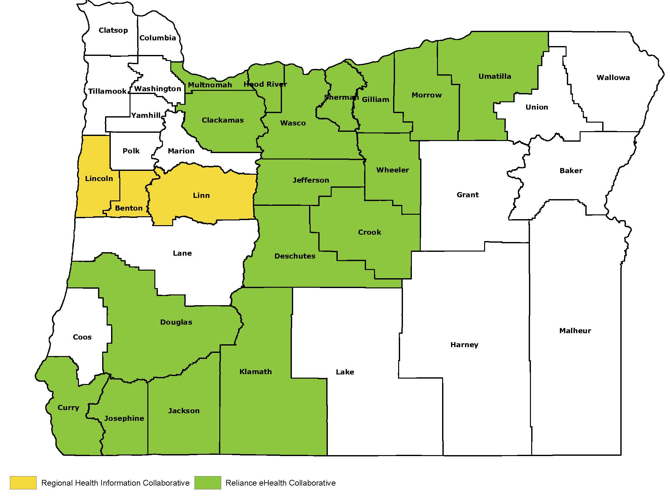
Regional Health Information Exchange Coverage
Notes:
-Reliance eHealth Collaborative (formerly Jefferson HIE) will begin flowing EDIE’s admit, discharge and transfer data to its members late spring 2017

Slide 16
National Efforts Support Document Exchange; Gain HIE Footprint in Oregon
 | Description
Carequality | Common Rules of the Road Standardized implementations to query records, No technology - most aligning with Surescripts RLS Driven by implementers– data sharing networks (Epic, Netsmart, other major EHRs)
CommonWell | An alliance of vendors for HIE (Cerner, Allscripts, eClinicalWorks, other major EHRs) Provides a central technology to query records Implementing Carequality
eHealth Exchange | Federal agency query network VA, SSA, DoD, Oregon entities
Epic Care Everywhere | Allows for record sharing among Epic customers and also eHealth Exchange, Carequality and Direct secure messaging

Slide 17
Statewide HIE and “Network of Networks”
Goal to have minimum core data available wherever Oregonians receive care or services across the state
Basic movement of health information is improving but
Significant gaps remain
Barriers to HIE: technology, organizational culture, trust
Ensuring HIE is meaningful is complex
“Raising all boats” to connect providers across the state can best be accomplished together
Statewide efforts and shared governance can play a significant role

Slide 18
HIT Efforts in Development (2017-2019)
Health information exchange
Develop “Network of Networks” for HIE
Bring Medicaid providers onto robust network of HIEs
Provide access to high-value data (e.g., PDMP)
Improve consent and privacy practices
Infrastructure and statewide HIT
Provider directory and Common credentialing programs
Clinical Quality Metrics Registry
Shared governance for Oregon HIT
HIT Commons, building off EDIE Utility

Slide 19
HIE Onboarding Program (2018-2021)
Fund onboarding costs for critical Medicaid physical, behavioral, oral health care providers to Community-Based HIEs
Priority Provider types | Specific Providers
Behavioral health | CMHPs, CCBHCs, behavioral health homes, ACT teams, mobile crisis teams
Oral health | Clinics contracted with Medicaid DCOs
Critical physical health | Medicaid providers who participate in: PCPCH, FQHCs, RHCs, CPC+, tribal health, equity-focused clinics, county corrections health
Major trading partners | Major trading partners that create value for priority Medicaid providers
Later phases likely to include: LTSS, social services, etc.

Slide 20
HIT Commons (2018+)
New Public/Private Partnership
Building off EDIE Utility model
Coordinate statewide HIT efforts
EDIE Utility
Network of Networks for HIE
PDMP Gateway
Other projects possible
Governance role for CCOs and others
Opportunity for influence
Shared funding
Leveraging federal Medicaid 90/10 matching funds
OHA/OHLC developing business plan

Slide 21
Learn more about Oregon’s HIT/HIE developments and Subscribe to our email list!
www.HealthIT.Oregon.gov
OHA Behavioral Health Information Sharing Resources:
www.oregon.gov/oha/HPA/CSI-BHP/Pages/Behavioral-Health-Info.aspx
Susan Otter
Director of Health Information Technology Susan.Otter@state.or.us
Marta Makarushka
Lead HIT Policy Analyst Marta.M.Makarushka@state.or.us

