Slide 1
Our pledge: reliability, integrity and trust
Formerly Jefferson Health Information Exchange

Slide 2
Who We Are
Neutral Third-Party since 2012
Non-Profit Membership Organization
Volunteer Board of Directors
Support providers, their patients and those who pay for their care to:
Realize opportunities to improve health
Improve the patient/client experience
Optimize health care efficiency and coordination
Manage health care costs
Notes:
JHIE is a grass-roots organization started by physicians, public health, mental health, hospitals and CCOs looking to improve health care quality, efficiency and reduce costs through better, more accessible patient information.
JHIE puts the patient at the center of the universe; and puts great emphasis on the privacy and security of a patient’s health information.
JHIE ensures that those who care for a patient have a seamless experience where they can view a patient’s health information in a concise record, fed by other providers in the care team, to support treatment decisions.
That means that patients get the best care possible and do not have to be subjected to repeat tests and treatment.

Slide 3
What we do…
Accurate, actionable
information
that follows the patient…
Right at your
fingertips
Notes:
As the health care environment transitions to electronic records, there has been a growing need to integrate data through health information exchange (HIE).
HIE is the secure, electronic exchange of health information among authorized providers that is patient centered. So patient’s don’t have to carry their records with them; instead they follow the patient wherever they access health care. – such as health care providers, hospitals and public health agencies.
This exchange of health care information improves patient care and reduces costs by fostering care collaboration and lowering administrative burden. For example, referrals can be done electronically with all the relevant information attached to help the specialist better care for the patient. It reduces the need for unnecessary testing and exposure to radiation for the patient and for the clinic, there is a more streamlined workflow that reduces the staff time needed to support a referral. The system also allows for the referral loop to be closed so the primary doctor knows when the patient has been seen and the plan of treatment that has been prescribed.

Slide 4
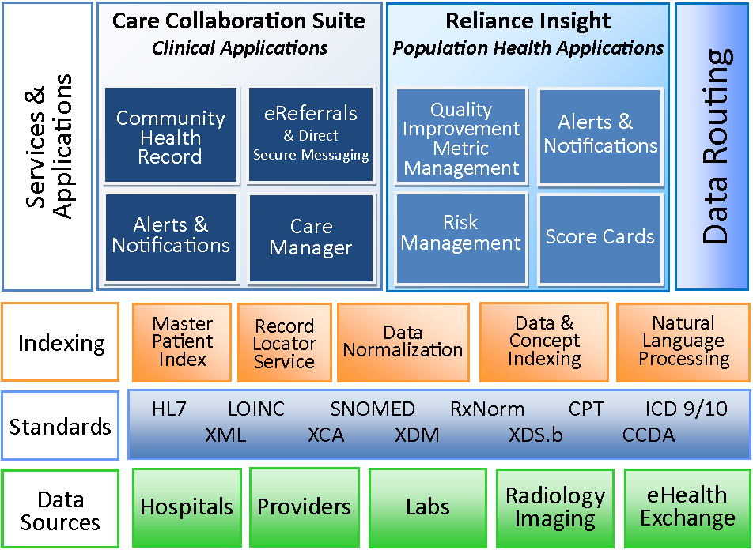
Architecture

Slide 5
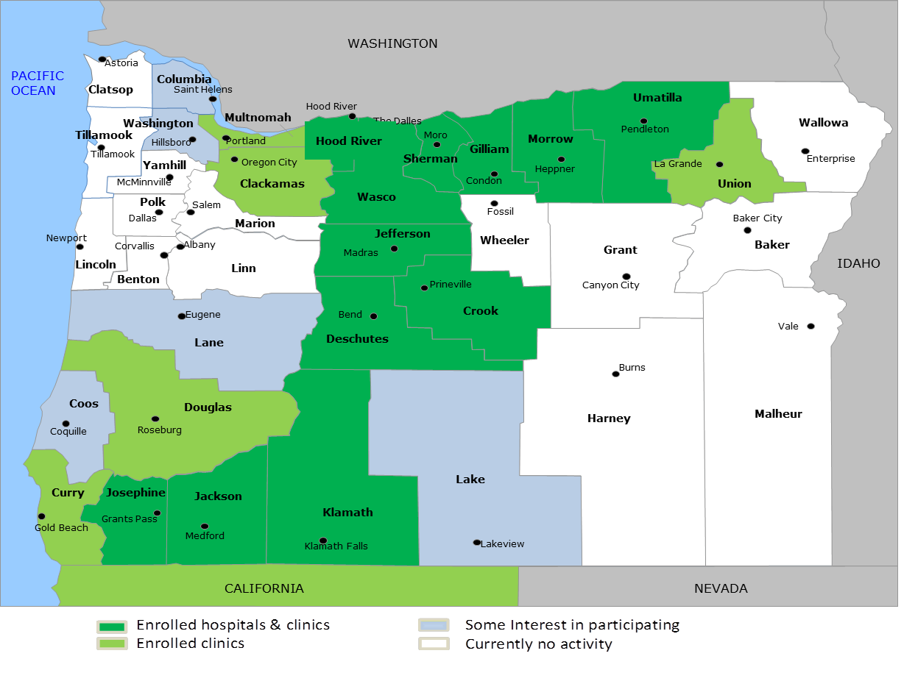
Coverage Area
Participation
16 Oregon Counties
11 Hospitals
~300 practices/ clinics
264 Interfaces/127 ambulatory CCDs
12+ EHR vendors
6 Coordinated Care Organizations
4 CCBHCs
7 Substance Use Treatment Providers connecting

Slide 6
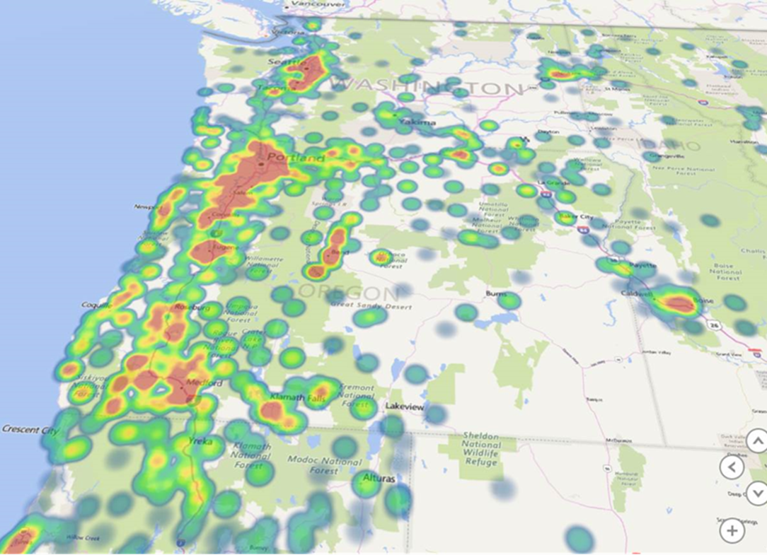
Patients by Zip Code

Slide 7
Privacy and Security Considerations (HIPAA Covered Health Information)
Patient Non-Participation (opt-out)
User Roles and Access Controls
Based on patient-provider relationship
Based on User’s “need to know”
User training to reinforce appropriate use
Privacy & security policies (HIPAA, 42CFR Part 2)
Monitoring usage
Sanctions for misuse

Slide 8
Consent Management Model
for Behavioral Health Information Exchange

Slide 9
Purpose
Bridge the information divide between physical health care and behavioral health care services and providers
Support coordination across the care team
Improve care for those with serious mental illness who are 3times more likely to have comorbidities (diabetes, diseases of the heart, respiratory disorders, stroke and arthritis)

Slide 10
Principles: BH Information Exchange
Lawfully Integrate Physical and Behavioral Health Information Exchange
Develop universal interpretation of law for the exchange, disclosure, and re-disclosure of drug, alcohol and mental health data
Develop common consent management model (CMM)
Common Release of Information form
Requirements for electronic data exchange
Implement CMM within Reliance technology to enable robust exchange
Connect with behavioral health EHRs

Slide 11
Findings: Managing Consent
Qualified Service Organization Agreement
Required between Reliance and data contributors
Consent must be captured for disclosure of:
Addictions information (42 CFR Part 2)
Psychotherapy notes
Re-disclosure is not allowed without explicit patient consent
Bona fide emergencies allow for disclosure without consent
Patient has right to identify specific users and health information to be disclosed
Patient has right to request an accounting of disclosures

Slide 12
Consent Model Parameters
Supported Release of Information (ROI)
Release must be given at each SUT facility
Full record from SUT facility authorized for release
Release must allow for:
Provider Organization (e.g., PCP Office, Inpatient facility, etc…)
All person’s treatment providers in the HIE
Bona fide emergency access and reporting
Partial consent will not be managed through Reliance
Current workflow will continue to be used

Slide 13
Consent Model Functionality
Consented period
Defaults to 1 year
May be changed based on ROI
Role-Based User Access Controls
Reporting of Disclosures
Configurable reports for providers
Patients/Clients can request a report
CCO Data Routing
Based on member’s consent and active coverage
Fully Compliant with 42 CFR Part 2 as amended March 2017

Slide 14
Challenges
Consensus on Legal Requirements
Technology Challenges
EHR Vendor Capabilities & Competition
Removing Stigma & Communicating Benefits
Consistent Message for Informed Consent

Slide 15
Opportunities*
Expanding purpose of consent model
Granting consent for other members of the care team
social service organizations, patient advocates, health navigators, court-ordered treatment, etc.
Fully integrating social, behavioral, physical and dental to care for whole patient/family based on patient consent.
Uncharted territory and possibilities
*Requires much thought and consideration to the patient’s rights and impact (+/-) on their wellbeing

Slide 16
Questions? Comments! Concerns…

Slide 17
Guiding Principles
Patient-centered
Community-driven
Provider-led collaboration
Secure and trusted
Provides value to patients, the providers who care for them and those who pay for their care
Notes:
JHIE is a grass-roots organization started by physicians, public health, mental health, hospitals and CCOs looking to improve health care quality, efficiency and reduce costs through better, more accessible patient information.
JHIE puts the patient at the center of the universe; and puts great emphasis on the privacy and security of a patient’s health information.
JHIE ensures that those who care for a patient have a seamless experience where they can view a patient’s health information in a concise record, fed by other providers in the care team, to support treatment decisions.
That means that patients get the best care possible and do not have to be subjected to repeat tests and treatment.

